Slide 1
This presentation is part of a self-paced learning package for kindergarten services. The package contains guidance and additional resources.
Read — Self-paced learning package: Guidance. This will provide the context and purpose of the module.
Prepare your materials. Ensure you have a copy (printed or digital) of the:
QKLG 2024
Module 3: Workbook
Considerations for planning — examples 1 and 2
Check the notes section. Each slide may include additional information in the notes section (use Normal view).
Before you start

Slide 2
Look for activity icons.
Throughout this presentation, icons are used indicate different activities.
Before you start
Refer to your workbook
Pause and reflect
Refer to the QKLG 2024

Slide 3
QKLG 2024 Familiarisation and planning
241236
Module 3: Identifying considerations for planning
Notes:
Welcome to familiarisation and planning with the Queensland kindergarten learning guideline (QKLG) 2024, Module 3: Identifying considerations for planning.

Slide 4
Acknowledgment of Country
Notes:
Acknowledgment of Country
Please read.

Slide 5
QKLG 2024 familiarisation and planning series
Module 1 Exploring revisions to purpose, principles and practices
QKLG 2024 and EYLF V2.0 alignment
Purpose, principles and practices
Module 2
Exploring continua and reviewing transitions
Continua of learning and development
Learning and development areas
Module 3
Examining considerations for planning
Considerations for planning with the QKLG 2024
Supporting transitions and continuity of learning
Notes:
This is Module 3 of 3 of the QKLG 2024 self-paced learning package.
This module focuses on examining considerations for planning using the QKLG. It is the self-paced version of the familiarisation and planning workshop of the same title.

Slide 6
Learning goal
Success criteria
To consider a planning framework that aligns with the QKLG 2024 to support high-quality kindergarten programs.
You will know you are successful if you can:
identify considerations that inform planning
reflect on how considerations for planning are evident in current planning practice
identify actions to support continuous improvement in planning practices.
Notes:
At the end of this module, you should have considered a planning framework that aligns with the QKLG 2024 to support high-quality kindergarten programs. You will have:
identified considerations that inform planning
reflected on how considerations for planning are evident in your current planning practice
identified actions to support continuous improvement in planning practices.

Slide 7
Module 3: Learning outline
Considerations for planning
Reflecting on practice
Identifying next steps
Notes:
The topics covered in this QKLG 2024 familiarisation and planning module are:
Considerations for planning
Reflecting on practice
Identifying next steps.
You will see this diagram at the start of each new topic in the module.
Let’s begin by exploring the considerations for planning with the QKLG.

Slide 8
Considerations for planning: Guidance
Queensland kindergarten learning guideline (QKLG)
Early Years Learning Framework (EYLF)
National Quality Framework (NQF)
Notes:
The National Quality Framework (NQF) provides a national approach to regulation, assessment and quality improvement for early childhood education and care. The NQF includes the national law and regulations, National Quality Standard (NQS) and assessment and quality rating processes against nationally approved frameworks. NQS refers to the Early Years Learning Framework (EYLF) to which the QKLG is aligned. In Module 1, the alignment of the EYLF V2.0 and QKLG 2024 was described.
As you examine considerations for planning, you will be exploring the guiding advice from these three documents to highlight their alignment with and support for quality practice.

Slide 9
Planning processes: NQF and EYLF V2.0
Collect information
Analyse
Plan
Implement
Reflect and evaluate
Notes:
The Guide to the NQF and the EYLF V2.0 provide planning cycles that describe planning processes informing educational plans.
The focus in this module will be on the plan process of the cycle. QKLG 2024 guidance will be used to frame considerations informing your plans and encourage you to critically reflect on your own planning practice using the QKLG.

Slide 10
Activity 1: Considerations for planning
Read and reflect
Read the practice Engaging in responsive planning and decision-making (p. 13) in your QKLG 2024.
Identify teaching and learning considerations for planning.
In your workbook — p. 2
List these considerations.
Notes:
To review the considerations for planning:
read Engaging in responsive planning and decision-making — QKLG (p. 13)
complete Activity 1: Considerations for planning — Module 3 workbook (p. 2).

Slide 11
Check-in: Considerations for planning
Engaging in responsive planning and decision-making
Responsive planning and decision-making is an ongoing, interconnected and reciprocal process. It is based on teachers’ understandings about, and conversations with, children, educators, parents/carers, family and community members, and professional partners.
Teacher-initiated planning involves short-, medium- and long-term decisions that build on children’s knowledge, perspectives, capabilities and interests. Planning is flexible and responds to child-initiated, spontaneous opportunities to explore new learning with children.
Notes:
From the practice Engaging in responsive planning and decision-making, key considerations for planning that you may have identified include:
the ongoing and interconnected process of planning and assessment
collaborating with partners throughout planning
learning over time through long-, medium- and short-term decision-making
balancing teacher-initiated planning with responsiveness to child-initiated, spontaneous learning that builds on children’s knowledge, perspectives, capabilities and interests inform planning.

Slide 12
Check-in: Considerations for planning (continued)
Engaging in responsive planning and decision-making
Teachers and educators:
focus on learning priorities, learning environments and contexts for individuals, small groups and the whole group
provide children with opportunities to exercise agency and play an active role in their own learning by
contributing to shared thinking, planning and organising for learning
negotiating ways to follow their interests and ideas
participating in collaborative decision-making and reflection about routines or changes that may affect them
engaging in conversations to reflect on what they have learnt and consider their next steps for learning
document children’s participation in the kindergarten program and their ongoing learning progress
use documentation to support collaborative reflection and decision-making about learning with children, parents/carers and family members.
Notes:
Key considerations for planning continued include:
focusing on learning priorities in relation to the context of the service and group
collaborating with children and supporting their active participation in planning
assessing and documenting children’s learning to support collaborative decision-making and critical reflection to inform ongoing planning and share children’s learning progress.

Slide 13
Check-in: Considerations for planning — visual summary
Collaboration
Context
Learning priorities
Reflection
Assessment
Balance of planned and spontaneous learning
Documentation
Time
Notes:
The key considerations for planning from the QKLG advice (Slides 11 and 12) are represented in the visual summary above. These considerations will guide your thinking throughout the module.

Slide 14
Considerations for planning: Documentation
Collaboration
Context
Learning priorities
Reflection
Assessment
Balance of planned and spontaneous learning
Documentation
Time
Notes:
These considerations guide what professional decisions are made in relation to the educational plan. The National Quality Framework (NQF) advice can support informed decision-making about how teachers and educators approach documenting the educational plan. This advice will be discussed in the following two slides.

Slide 15
Considerations for planning: Documentation
'The National Regulations define what must be done to
comply with Section 168 of the Education and Care Services
National Law but they do not prescribe how to do it or what
educational documentation must look like.'
Source: Australian Children’s Education and Care Quality Authority (ACECQA) 2024, Quality Area 1: Educational program documentation for educators and teachers ― Early childhood (National Quality Standard: Information sheet), p. 2, www.acecqa.gov.au/resources/supporting-materials/infosheet.
Notes:
The National Quality Framework (NQF) and National Quality Standard (NQS) indicate there is no prescribed way to document your educational plan.

Slide 16
Considerations for planning: Documentation (continued)
‘In collaboration with service and educational leaders, approved providers will make informed decisions on the best approach to documentation to maintain compliance, meet the National Quality Standard (NQS) and support educators to effectively deliver and document programs that enhance outcomes for the children, young people and their families.’
Source: Australian Children’s Education and Care Quality Authority (ACECQA) 2024, Quality Area 1: Educational program documentation for educators and teachers ― Early childhood (National Quality Standard: Information sheet), p. 2, www.acecqa.gov.au/resources/supporting-materials/infosheet.
Notes:
To paraphrase the ACECQA: In collaboration, services consider their approach to documenting the educational plan in a way that will support teachers and educators to effectively deliver and document the program and enhance outcomes for children.
As you continue to examine the considerations for planning outlined in the QKLG 2024, reflect on how you document these considerations and how effective your current practice is in maintaining documentation and enhancing outcomes for children.

Slide 17
Considerations for planning: Context
Collaboration
Context
Learning priorities
Reflection
Assessment
Balance of planned and spontaneous learning
Documentation
Time
Notes:
Planning is informed by, and responsive to the context.

Slide 18
Considerations for planning: Context
QKLG 2024 | EYLF V2.0 | Guide to NQF
Teachers and educators focus on learning contexts for individuals, small groups and the whole group. | ‘Educators make many decisions about curriculum planning based on their professional knowledge, their knowledge of children and local contexts … ’ (AGDE 2022, p. 27). | ‘Educators understand the context of the service and how the service’s statement of philosophy guides their decision-making’ (ACECQA 2024, p. 124).
Notes:
In the QKLG, EYLF v2.0, and NQF, context refers to service and local contextual understandings that guide decision-making about learning environments, ensuring they are relevant and meaningful to both the group and individuals.

Slide 19
Activity 2: Consider context
Reflect
What are the contextual factors that support your understanding of your local community, the kindergarten group and individual children where you work?
In your workbook — p. 2
Describe these factors by writing a contextual overview for your current group of children.
Notes:
Reflect on the contextual factors of your service.
Complete Activity 2: Consider context — Module 3 workbook (p. 2).

Slide 20
Considerations for planning: Learning priorities and time
Collaboration
Context
Learning priorities
Reflection
Assessment
Balance of planned and spontaneous learning
Documentation
Time
Notes:
Planning makes visible your identified learning priorities over time.

Slide 21
Considerations for planning: Learning priorities and time
QKLG 2024 | EYLF V2.0 | Guide to NQF
Teachers and educators focus on and plan for learning priorities in the short-, medium- and long-term for individuals, small groups and the whole group (QKLG, p. 13). | ‘Using assessment and evaluation information, educators in collaboration with children, families and other professionals formulate short- and long-term learning goals for each child’ (AGDE 2022, p. 25) ‘ … and plan meaningful learning experiences for children and groups of children’ (AGDE 2022, p. 28). | Using assessment and evaluation information, educators ‘in collaboration with children, families and other professionals formulate short and long-term learning goals for each child’ (ACECQA 2024, p. 386) as well as plan the program to ‘support achievement of group goals’ (ACECQA 2024, p. 125).
Time
Learning priorities
Notes:
Learning priorities are informed by the context to ensure they are meaningful for the group and for individuals. Decisions about learning priorities are based on assessment evidence and identify plans and priorities for learning over long-, medium- and short-term periods of time.
QKLG learning priorities (referred to as goals in the EYLF V2.0 and NQF):
draw from the learning and development area significant learnings
respond to the context and group
build on children’s knowledge, perspectives, capabilities and interests
identify learning across long-, medium- and short-term periods of time.

Slide 22
Considerations for planning: Time
Long term
Range and balance of contextualised learning priorities over time
Medium term
Teacher-initiated teaching, learning and assessment plans working towards identified priorities
Short
term
Child-initiated and spontaneous learning facilitated alongside planned learning
Notes:
Planning decisions are made over long, medium and short terms as described on the slide.

Slide 23
Considerations for planning: Learning and assessment
Collaboration
Context
Learning priorities
Reflection
Assessment
Balance of planned and spontaneous learning
Documentation
Time
Notes:
Planning includes a balance of learning opportunities that are:
planned, initiated and guided by the teacher or educator
responsive to child-initiated, spontaneous learning moments.
Planning for learning also considers planning for assessment including what, how and when evidence may be gathered in relation to the learning priorities to inform ongoing decision-making.

Slide 24
Considerations for planning: Learning and assessment
QKLG 2024 | EYLF V2.0 | Guide to NQF
Planning involves: teacher-initiated planning flexibility and responsiveness to child-initiated and spontaneous opportunities (QKLG, p. 13). | Provide a balance between child-led and adult initiated and guided play (AGDE 2022, p. 22). | Planning ensures that … educators’ practice is intentional and supports children to progress towards the learning outcomes (ACECQA 2024, p. 123).
Notes:
The QKLG, EYLF and NQF identify that quality planning includes a balance of planned and spontaneous intentional learning opportunities which support children to progress towards the learning priorities.

Slide 25
Planned and spontaneous learning
Review and reflect
Consider the balance of planned and spontaneous learning in your current practice.
Review your planning documents and identify:
instances of teacher-initiated and guided learning
examples of spontaneous, child-initiated learning.
Reflect on the balance
Assess how these different types of learning are represented in your planning.
Consider what this balance might mean for your planning practice and how it supports children’s learning and development.
Notes:
Review and reflect to consider the balance of planned and spontaneous learning in your current practice.

Slide 26
Considerations for planning: Reflection
Collaboration
Context
Learning priorities
Reflection
Assessment
Balance of planned and spontaneous learning
Documentation
Time
Notes:
Critical reflection is an integral part of effective planning to support collaborative decision-making about teaching and learning, and to identify ways to develop or extend what is in the plan.

Slide 27
Considerations for planning: Reflection
QKLG 2024 | EYLF V2.0 | Guide to NQF
‘Evaluation of program and practice to identify ways of improving teaching, learning and relationships’ (QKLG 2024, p. 10). | ‘Educators use their assessment of, as and for children’s learning to evaluate the implementation of plans. Educators consider how meaningful and effective the plans have been for children’s learning development and wellbeing, giving considerations to children’s cultural and linguistic identities and diverse capabilities’ (AGDE 2022, p. 28). | ‘Critical reflection on children’s learning and development, both as individuals and in groups, drives program planning and implementation’ (ACECQA 2024, p. 141).
Notes:
Critical reflection, including evaluation, is an ongoing process that informs decisions about children’s learning and teacher professional practice.

Slide 28
Activity 3: Consider critical reflection
Consider your current critical reflection process.
In your workbook — p.3
Note your process for:
what you reflect on to evaluate program, practices and learning
who you reflect with
when you engage in critical reflection
how you document reflections?
Notes:
Consider you current critical reflection process:
Complete Activity 3: Consider critical reflection — Module 3 workbook (p. 3).

Slide 29
Module 3: Learning outline
Considerations for planning
Reflecting on practice
Identifying next steps
Notes:
In this section, you will use the considerations for planning to reflect on how you document these considerations across long-, medium- and short-term planning documents.

Slide 30
Planning decisions: Considerations in action
Use Considerations for planning — Example 1 and 2 templates to reflect on long-, medium- and short-term planning for a whole kindergarten group as you work through the next section of the module.
Notes:
As you reflect on example template 1 and 2 (provided in this module) and your own documentation of considerations for planning, you will see connections to the visual summary of considerations.
You will need:
Considerations for planning: Long-term planning decisions — Module 3 self-paced learning — Example 1 template
Considerations for planning: Medium- and short-term planning decisions — Module 3 self-paced learning — Example 2 template.

Slide 31
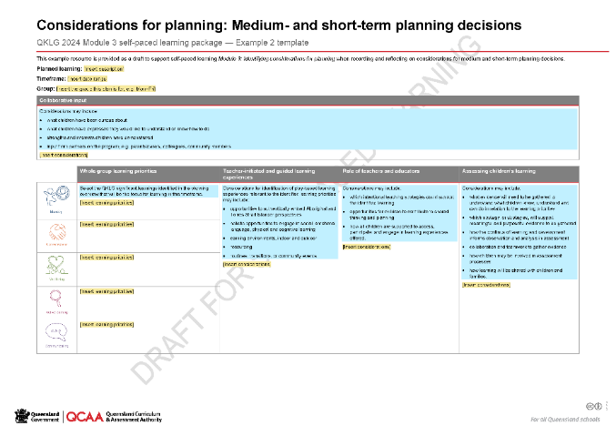
Module 3 considerations for planning examples 1 and 2
Notes:
In this part of the module, you will explore where you can see the QKLG considerations for planning represented in Module 3: Example plans to review considerations for planning 1 and 2. These two templates are one example of how the QKLG considerations for planning could be represented in planning documentation. They will be used to exemplify where the considerations can be seen in long-, medium- and short-term planning when making decisions for the whole kindergarten group.
These templates are only available for use with Module 3 for the purpose of exploring planning considerations.

Slide 32
Long-term planning
Long term
Range and balance of contextualised learning priorities over time.
Medium term
Teacher-initiated teaching, learning and assessment plans working towards identified priorities.
Short term
Child-initiated and spontaneous learning facilitated alongside planned learning.
Documentation
Notes:
Long-term planning documents professional decisions about the intended range and balance of learning, informed by the context, over an extended period of time. Determining the time frame for long-term planning is context based and may include yearly, half-yearly or quarterly time frames.
Long-term consideration of the range and balance of learning is a way to ensure coverage of learning across the QKLG has occurred.

Slide 33
Long-term planning: Context
Context
Notes:
Making decisions and planning for learning that is relevant to the service context and group of children is embedded in the QKLG principles, practices and learning and development areas. Identifying factors which influence teaching and learning in your context is an important first step in planning for child-centred, meaningful learning.
Examples of contextual factors that may be considered by teachers and educators is on the slide. You may like to think about other contextual factors you would consider for your service and group. These were considered in Activity 2.

Slide 34
Long-term planning: Purpose and intent
Context
Reflection
Balance of planned and spontaneous learning
Notes:
Consideration of context can inform decisions about purposeful, intended learning that responds to the context and group of children over a long-term period.
Long-term planning may be considered in distinct blocks of time that enables learning to be prioritised and explored in depth while demonstrating how learning can be built on and extended over time.
In the on-screen example, a long-term focus of one year divided into four quarters is exemplified. Each block of time would be a description of the intended purpose of learning for that period.

Slide 35
Activity 4: Purpose and intent
Identifying purpose and intent
Consider a new kindergarten group. What contextual factors from Activity 3 need to be considered when planning?
In your workbook — p. 4
Describe the purpose and intent of learning at the start of the year (first block of time).
Example If you have a group with many children new to the service, one intent may be to build belonging through supporting positive interactions with others.
Notes:
Consider your own purpose and intent.
Complete Activity 4: Purpose and intent — Module 3 workbook (p. 4).

Slide 36
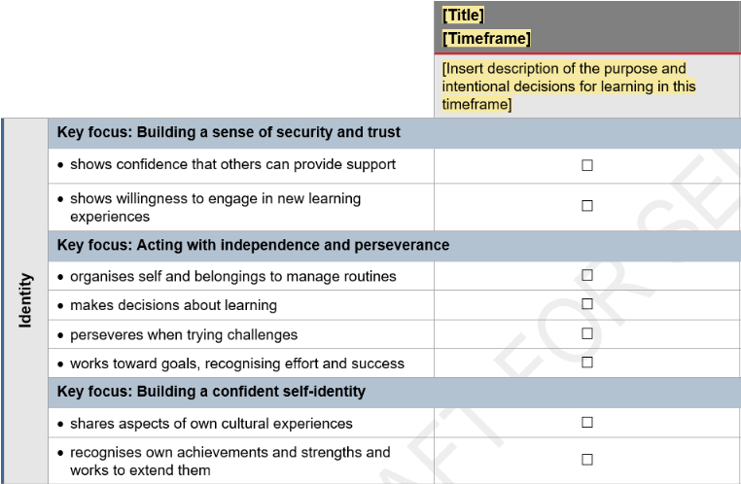
Long-term planning: Learning priorities
Context
Reflection
Balance of planned and spontaneous learning
Learning priorities
Notes:
Significant learning priorities that will promote purposeful, intended learning can then be determined for each block of time. These are learning priorities for the whole group.
For example, if the intended purpose of the first block of time is getting to know and settling in a new group of kindergarten children as described in Activity 4, prioritising identity and connectedness significant learnings to promote relationship building, connecting with others, managing routines and building confidence in a new environment would be appropriate.

Slide 37
Activity 5: Learning priorities
Identifying learning priorities
Expand on your description of the purpose and intent for learning at the start of the year from Activity 4.
Use the QKLG to identify significant learnings you would prioritise to promote the described purpose and intent for learning.
In your workbook — p. 4
Record the significant learnings you identify.
Notes:
Use the QKLG to identify significant learnings you would prioritise to promote the described purpose and intent for learning from Activity 4.
Complete Activity 5: Learning priorities — Module 3 workbook (p. 4).

Slide 38
Pause and reflect
Reflect on learning priorities in your current planning.
How do you make decisions about group learning priorities?
How do you document the group’s learning priorities?
How do these priorities inform teaching, learning and assessment?
What would you like to continue or adapt in your planning practice?
Notes:
Make any notes of reflection on the Additional notes page at the end of your workbook.

Slide 39
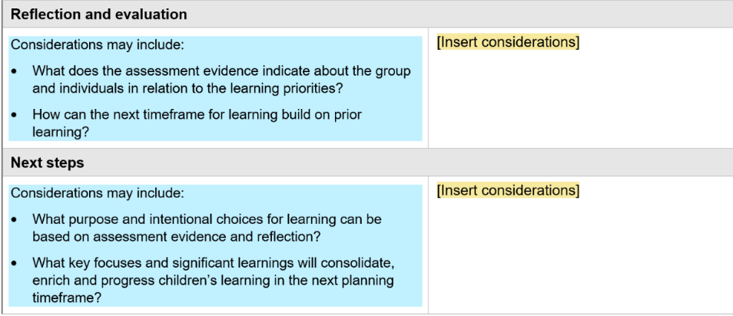
Long term planning: Reflection
Reflection
Collaboration
Notes:
Reflecting on program and practice at the end of each block of time, individually or collaboratively, supports teachers and educators to review decisions about the group learning priorities for the next block of time and revise these if needed, based on reflections of former blocks of time.

Slide 40
Considerations evident in long-term planning
Collaboration
Context
Learning priorities
Reflection
Assessment
Balance of planned and spontaneous learning
Documentation
Time
Notes:
When reflecting on long-term planning, you considered:
ways to document long-term planning decisions
long-term (time) decisions about purpose and range and balance of learning
planned learning and significant learning priorities informed by the context
critical reflection (collaboratively and individually) informing future (time) learning decisions for a whole group of children.

Slide 41
Pause and reflect
Reflect on long-term planning.
How do you engage in long-term planning?
How does long-term planning benefit teaching and learning?
Notes:
Make any notes of reflection on the Additional notes on the final page of your workbook.

Slide 42
Medium-term planning
Long term
Range and balance of contextualised learning priorities over time.
Medium term
Teacher-initiated teaching, learning and assessment plans working towards identified priorities.
Short term
Child-initiated and spontaneous learning facilitated alongside planned learning.
Notes:
Medium-term planning draws on long-term planning decisions to evidence the teacher-initiated and guided learning experiences, and assessment, supporting children to progress towards the learning priorities for the group and individuals.

Slide 43
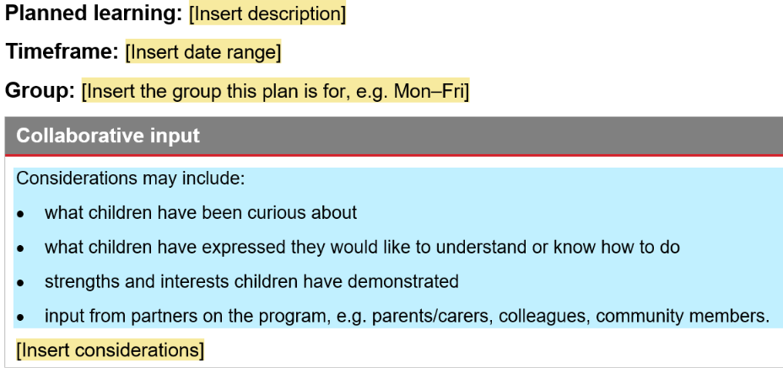
Medium-term planning: Collaborative input
Context
Collaboration
Notes:
Medium-term planning connects to the context and intended learning in the long-term plan, in the Planned learning field of the example (above). A decision is then made about the medium-term timeframe this plan will cover. For example, if the long-term plan demonstrated quarterly blocks of intended learning, the medium-term planning would consider how many weeks of a quarter the plan would cover.
The intent and purpose of learning identified in the long-term plan can be contextualised further in the medium-term plan by including collaborative input. Considerations for this input are displayed on the slide. You can consider other collaborative input you would include in your context.

Slide 44
Activity 6: Collaborative input
Identify collaborative partnerships
Consider how input from collaborative partnerships is encouraged and valued in your planning.
In your workbook — p. 5
Make a note of how you document this collaborative input in your planning.
Notes:
Consider how input from collaborative partnerships is encouraged and valued in your planning.
Complete Activity 6: Collaborative input — Module 3 workbook (p. 5).

Slide 45
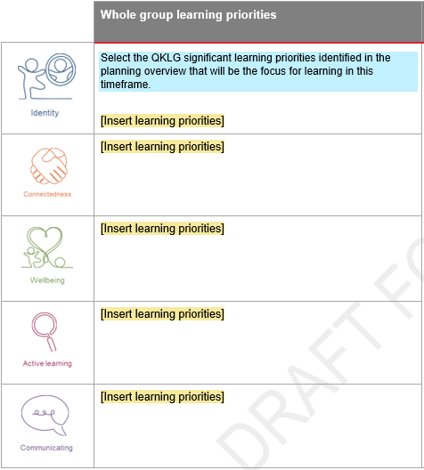
Medium-term planning: Learning priorities
Context
Reflection
Learning priorities
Notes:
Decisions are then made about the whole group significant learning priorities from the long-term plan that will be focused on in the medium term. You may draw on the whole group priorities to identify individual child priorities that would support their learning towards that significant learning priority.
Consideration of timeframe and opportunity to deeply engage in and consolidate learning in different learning situations informs professional decision-making about the number of significant learning priorities to focus on.
Learning is connected across the learning and development areas and these connections are visible in the selection of learning priorities. For example, if the intent of learning is to build relationships with others to develop a sense of belonging in kindergarten, priorities in identity and connectedness would be selected here.

Slide 46
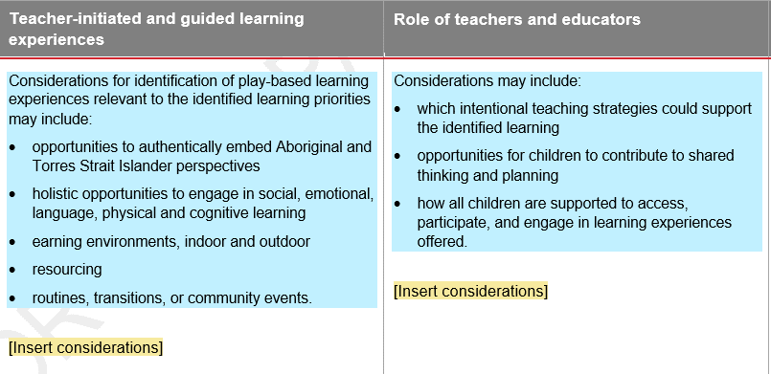
Medium-term planning: Learning experiences and the role of teachers and educators
Context
Reflection
Learning priorities
Balance of planned and spontaneous learning
Collaboration
Notes:
Learning experiences, environments and the role of adults to promote and support the learning priorities are documented in greater detail in the medium-term plan. This makes teaching and learning visible to others and promotes collaboration and teamwork when implementing plans.

Slide 47
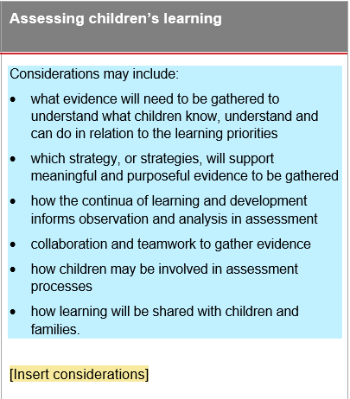
Medium-term planning: Assessment
Collaboration
Assessment
Learning priorities
Notes:
Considerations for assessing children’s learning is included to:
build shared understanding and promote collaboration when collecting evidence of learning
strategically plan for the evidence of learning to collect, and how that evidence could be collected to support efficient ways of working.
Identifying assessment decisions in the plan assists all people working with the class to know the focus for learning for the group and their role in documenting this evidence of learning.

Slide 48
Activity 7: Assessment
Reflect on assessment
How do you make decisions about evidence of learning to collect?
How could shared understanding and teamwork be supported through your documentation?
In your workbook — p. 5
Make a note of what you could continue, start or stop to support efficient ways of working?
Notes:
Reflect on your own assessment practices.
Complete Activity 7: Assessment — Module 3 workbook (p. 5).

Slide 49
Short-term planning
Long
term
Range and balance of contextualised learning priorities over time.
Medium
term
Teacher-initiated teaching, learning and assessment plans working towards identified priorities.
Short
term
Child-initiated and spontaneous learning facilitated alongside planned learning.
Notes:
Short-term planning demonstrates how teachers and educators recognise, value and respond to what children are interested in and want to learn.

Slide 50
Short-term planning
Context
Reflection
Learning priorities
Assessment
Documentation
Collaboration
Notes:
Spontaneous and child-initiated learning occurs alongside planned learning. As ideas and interests arise in the short term (e.g. daily/weekly/fortnightly), teachers make professional judgments about the learning to follow. These are guided by the learning priorities to ensure children have opportunities to develop the knowledge, skills and dispositions in the learning and development areas of the QKLG.

Slide 51
Medium and short-term planning: Critical reflection
Reflection
Collaboration
Notes:
Critical reflection and evaluation inform ongoing decisions between each medium-term block of time. This allows teachers to identify next steps for the learning children are ready for and adjust practice accordingly.

Slide 52
Considerations evident in medium- and short-term planning
Collaboration
Context
Learning priorities
Reflection
Assessment
Balance of planned and spontaneous learning
Documentation
Time
Notes:
When reflecting on medium- and short-term planning, you considered:
ways to document medium- and short-term planning decisions
evidencing the balance of planned and spontaneous learning over the medium- and short-term (time)
targeted learning priorities drawn from the long-term plan responding to the context
assessment and how this can strategically support collaboration and teamwork
critical reflection to inform future (time) learning decisions.

Slide 53
Activity 8: Reflecting on timeframes in planning
Reflect on timeframes in planning
What does medium- and short-term planning look like for you?
What would you like to think more about?
In your workbook — p. 6
Make a note of how these reflections will inform future practice.
Notes:
Reflect on your own timeframes in planning.
Complete Activity 8: Reflecting on timeframes in planning — Module 3 workbook (p. 6).

Slide 54
Module 3: Learning outline
Considerations for planning
Reflecting on practice
Identifying next steps
Notes:
This section of the module is dedicated to reflecting on your learning. Take the time to think about everything you have learned.
On the following slide, you will consider next steps to action in the future.

Slide 55
Activity 9: Reflect and evaluate
Reflect on the module
Drawing on your reflections across this module, consider next steps you will take.
In your workbook — p. 7
Write one thing you will continue, adapt, start, and stop.
Notes:
Reflect on what you want to do next with your new understandings.
Complete Activity 9: Reflect and evaluate — Module 3 workbook (p. 7).

Slide 56
QKLG 2024 familiarisation and planning series
Module 1 Exploring revisions to purpose, principles and practices
QKLG 2024 and EYLF V2.0 alignment
Purpose, principles and practices
Module 2
Exploring continua and reviewing transitions
Continua of learning and development
Learning and development areas
Module 3
Examining considerations for planning
Considerations for planning with the QKLG 2024
Supporting transitions and continuity of learning
Notes:
Congratulations on completing Module 3, the final module in the self-paced learning package.

Slide 57
Contact us
K–10 Curriculum and Assessment Branch
E qklg@qcaa.qld.edu.au
Notes:
Contact us: qklg@qcaa.qld.edu.au

Slide 58
References
Australian Government Department of Education (AGDE) 2022, ‘Belonging, Being and Becoming: The Early Years Learning Framework for Australia V2.0’, ACECQA: Approved learning Frameworks Version 2.0 — Communications toolkit www.acecqa.gov.au/acecqa-approved-learning-frameworks-version-2.0-communications-toolkit.
Australian Children’s Education and Care Quality Authority (ACECQA) 2022, ‘'Information sheet: BELONGING, BEING, BECOMING — The Early Years Learning Framework for Australia — V2.0, 2022' |www.acecqa.gov.au/sites/default/files/2020-01/Guide-to-the-NQF.pdf
Australian Children’s Education and Care Quality Authority (ACECQA) 2024, ‘Guide to the National Quality Framework: Interactive PDF’, Guide to the NQF www.acecqa.gov.au/nqf/about/guide.
Australian Children’s Education and Care Quality Authority (ACECQA) 2024, Quality Area 1: Educational program documentation for educators and teachers ― Early childhood (National Quality Standard: Information sheet), www.acecqa.gov.au/resources/supporting-materials/infosheet.

Slide 59
Acknowledgments
Third-party copyright material, and QCAA material not covered by the CC BY licence is listed below:
Queensland Government coat of arms, and the QCAA and QSA trademarks may not be reproduced without permission.
Acknowledgment of Country artwork (2023) ‘Growth through Learning’ by Chern’ee, Brooke and Jesse Sutton, Kalkadoon. www.cherneesutton.com.au
Student and staff images have been used with permission.
Australian Government Department of Education [AGDE] (2022). Belonging, Being and Becoming: The Early Years Learning Framework for Australia (V2.0). Australian Government Department of Education for the Ministerial Council. Licensed [Creative Commons Attribution 4.0 International](https://creativecommons.org/licenses/by/4.0) (CC BY 4.0)

Slide 60
Copyright notice
© State of Queensland (QCAA) [2024]
Licence: https://creativecommons.org/licenses/by/4.0 | Copyright notice: www.qcaa.qld.edu.au/copyright — lists the full terms and conditions, which specify certain exceptions to the licence. | Attribution (include the link): © State of Queensland (QCAA) [2024] www.qcaa.qld.edu.au/copyright.
Other copyright material in this presentation is listed on the previous slide/s.

Slide 61
QCAA social media

