Slide 1

This presentation is part of a self-paced learning package for kindergarten services. The package contains guidance and additional resources.
Read — Self-paced learning package: Guidance.
This will provide the context and purpose of the module.
Prepare your materials.
Ensure you have a copy (printed or digital) of the:
  QKLG 2024
  Module 2: Workbook
  Insights and reflection sheet.
Check the notes section.
Each slide may include additional information
in the notes section (use Normal view).
Before you start

Slide 2


Look for activity icons.
Throughout this presentation, icons are used indicate different activities.
Before you start
Refer to your workbook
Pause and reflect
Refer to the QKLG 2024

Slide 3
Familiarisation and planning self-paced learning
241234
Module 2: Exploring the continua and reviewing transitions
Notes:
Welcome to familiarisation and planning with the Queensland kindergarten learning guideline (QKLG) 2024, Module 2: Exploring the continua and reviewing transitions.

Slide 4
Acknowledgment of Country
Notes:
Acknowledgment of Country
Please read.

Slide 5
QKLG 2024 familiarisation and planning series
Module 1 Exploring revisions to purpose, principles and practices
QKLG 2024 and
EYLF V2.0 alignment
Purpose, principles and practices
Module 2
Exploring continua and reviewing transitions
Continua of learning and development
Learning and development areas
Module 3
Examining considerations for planning
Considerations for planning with the QKLG 2024
Supporting transitions and continuity of learning
Notes:
This is Module 2 of 3 of the QKLG 2024 self-paced learning package.
This module explores the continua of learning and development, learning and development areas and supporting transitions and continuity of learning. It is the self-paced version of the familiarisation and planning workshop of the same title.

Slide 6
Overview: Revised QKLG elements
Module 1
Purpose
Updated vision statement and clarified relationship to EYLF V2.0.
Principles
Refined: 5
Added: 3
Practices
Expanded: 3 to 7
Refined: 6
Added: 1
Continua of learning and development
Added: Explanation of continua phases
Refined: Guidance on using continua
Refined:
Structure
Examples of observable learning
Examples to illustrate learning across continua
Module 2
Learning and development areas
Supporting transitions and continuity of learning
Expanded: The range of transitions in the advice. Refined: Supporting transition to school.
Notes:
The QKLG contains six interconnected elements, all of which have been revised.
This diagram shows how each of the elements has been revised — either refined, expanded, or added to.
The diagram will also guide you through the familiarisation package and show the progression toward Module 3: Identifying considerations for planning with the QKLG 2024.
Module 1 concluded with examining practices. In Module 2, the focus is on revisions to the continua of learning and development, learning and development areas and supporting transitions and continuity of learning. You will have the opportunity to reflect on any actions that you may take.

Slide 7
Learning goal
Success criteria
To understand the updates and revisions in the QKLG 2024 and prepare for implementation.
You will know you are successful if you can:
strengthen your knowledge of the QKLG 2024 continua, learning and development areas and transitions
identify QCAA resources to support familiarisation
identify actions to support implementation.
Notes:
At the end of this module, you should understand the updates and revisions in the QKLG 2024. You will have:
strengthened your knowledge of the QKLG 2024 continua, learning and development areas and transitions
identified QCAA resources to support familiarisation
identified actions to support implementation.

Slide 8

Module 2: Learning outline
Understanding the continua
QCAA resources to support familiarisation
Understanding learning and development areas
Supporting transitions and continuity of learning
Notes:
The topics covered in this QKLG 2024 familiarisation and planning module are:
Understanding the continua
Understanding learning and development areas
Supporting transitions and continuity of learning
QCAA resources to support familiarisation.
You will see this diagram at the start of each new topic in the module.
Let’s begin by exploring the continua of learning and development in the QKLG.

Slide 9
Understanding the continua
Purpose
Updated vision statement and clarified relationship to EYLF V2.0.
Principles
Refined 5.
Added 3 new.
Practices
Expanded from 3 to 7.
Refined 6.
Added 1 new.
Continua of learning and development
Added explanation of the continua phases.
Refined guidance on using the continua.
Learning and development areas
Refined structure.
Refined examples of observable learning and examples to illustrate learning across the continua.
Supporting transitions and continuity of learning
Expanded advice to include a range of transitions and refined supporting transition to school.
Notes:
The continua of learning and development is integral to planning for and assessing learning.

Slide 10

Understanding the continua of learning and development
Key revisions
Explained and refined phases of the continua using the continua
Notes:
The phases within the continua of learning and development have been revised to provide more detail through the explanation of the learning situation and level of support across the continua phases.

Slide 11
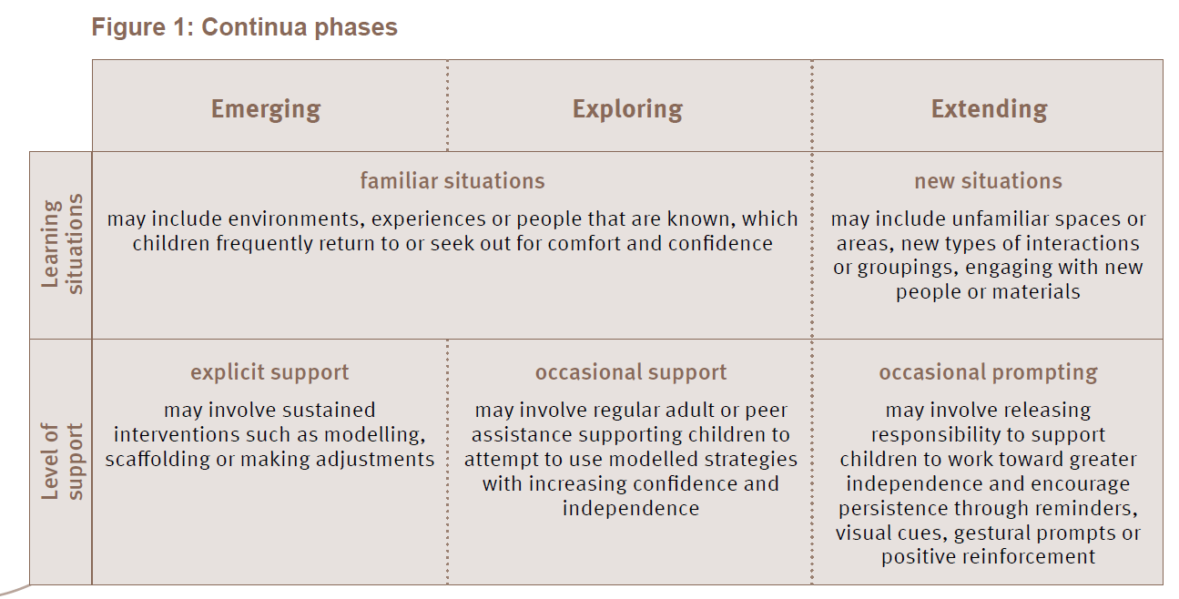
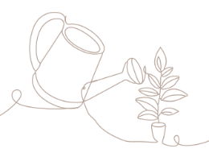
Phases of the continua
QKLG, p. 18
Notes:
The continua of learning and development is unique to the QKLG. It assists teachers as they observe, analyse and assess children’s learning, development and wellbeing. Teachers and educators use the continua to:
reflect on evidence of learning
inform ongoing decisions
share information about children’s learning.
The continua are described using three phases — emerging, exploring and extending. The phases inform teacher planning and learning discussions. Using the terms ‘emerging’, ‘exploring’ and ‘extending’ and the continua when sharing information about children’s learning with families should be considered.
Each phase is differentiated by the child’s level of:
familiarity with the learning situation
support needed to demonstrate learning.
The continua supports teachers and educators to understand not only what children know and can do but how they learn through identifying the level of familiarity and level of support for each phase in the continua (Figure 1).

Slide 12
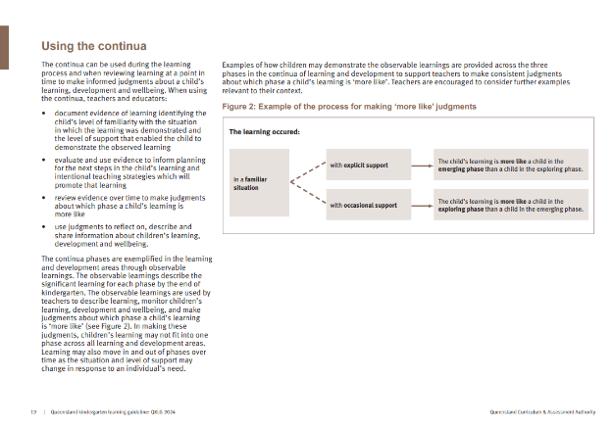

Using the continua
Read
  Read ‘Using the continua’ in the QKLG (p.19) to understand its purpose and structure.
  The advice here has been revised.
Notes:
Read to understand the revised Using the continua — QKLG (p.19).

Slide 13
Key advice for using the continua
  When using the continua, teachers and educators:
  observe and document learning, identifying the learning situation and level of support
  use evidence to inform planning and intentional teaching strategies
  review evidence of learning collected over time
  describe and share information about learning, development and wellbeing.
Notes:
The continua can be used during the learning process and when reviewing learning at a point in time to make informed judgments about a child’s learning, development and wellbeing (QKLG p. 19).

Slide 14
Activity 1: Reflecting on using the continua
Consider how you use the continua for teaching, learning and assessment.
Rank your use of the key advice for using the continua (QKLG p.19) on a scale of 1–4 where:
1 represents frequent use of the continua
4 represents infrequent use of the continua.
In your workbook — p. 2
Note your reflections and any new insights.
Notes:
Consider how you use the continua for teaching, learning and assessment.
Complete Activity 1: Reflecting on using the continua — Module 2 workbook (p. 2).

Slide 15
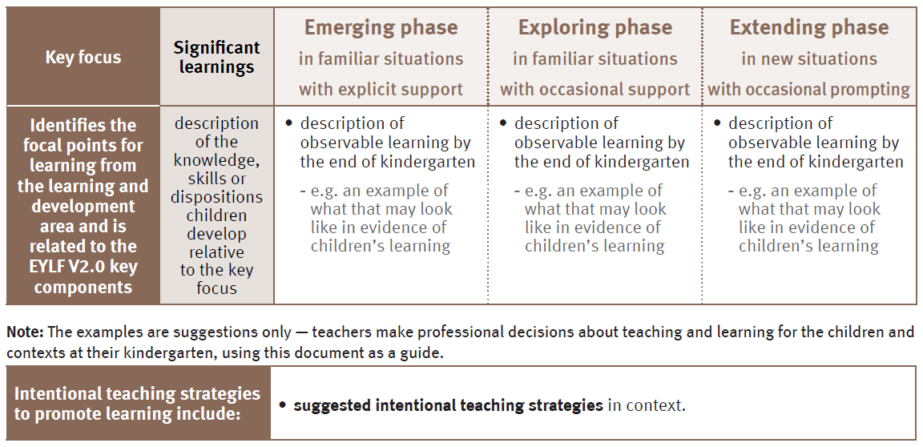
Embedded continua in the learning and development areas
QKLG, p. 22
Notes:
The revisions to the continua clarify the learning situation and the level of support across the phases. The continua is embedded in each of the learning and development areas and provides the structure of the focal point for learning (key focus), the knowledge, skills or dispositions relative to that focus (significant learnings) and the learning phases (Figure 3).
The best way to understand the revisions to the continua is to examine it in detail by looking at it in the context of a learning and development area.

Slide 16

Phases of the continua
Communicating: Building numeracy in personally meaningful ways
 | Significant learnings | Emerging in familiar situations with explicit support | Exploring in familiar situations with occasional support | Extending in new situations with occasional prompting
 | develops awareness of patterns | notices simple patterns | notices and copies simple patterns | describes created patterns
Communicating
Key:
Action or thought
Knowledge, skills or dispositions
Notes:
The continua phases are exemplified in the learning and development areas through the observable learnings. These describe the actions or thoughts (highlighted in teal) observed as children demonstrate the knowledge, skill or disposition (highlighted in yellow) in relation to the significant learning.
When reading each of the observable learning descriptions, you can see the range of actions or thoughts children may demonstrate that show their developing awareness of patterns in each phase, including noticing, noticing and copying, and describing.
The observable learnings can be used by teachers and educators to:
intentionally plan opportunities for children to learn and demonstrate range and depth of learning in relation to the significant learning
observe and analyse the learning situations and supports that enable children to successfully engage in learning and demonstrate what they know, understand and can do
review evidence of the range of learning demonstrated over time to make point-in-time judgments about which phase the child's learning is ‘more like’
describe and share information about what children's learning is ‘more like’ with others.

Slide 17
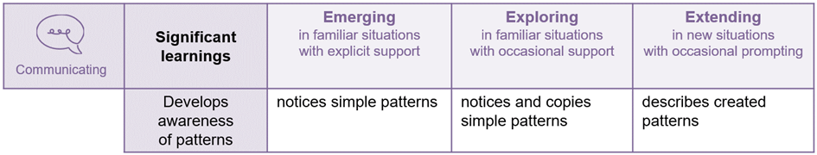
Activity 2: Planning and assessing using the continua
Pause and reflect
Reflect on what the observable learnings describe in relation to the significant learning.
In your workbook — p. 3
Consider this description of observable learnings in each phase of the continua.
How does the detail within the observable learning description inform planning and assessment for the key focus and significant learnings?
Notes:
Consider this description of observable learnings in each phase of the continua.
Complete Activity 2: Planning and assessing using the continua — Module 2 workbook (p. 3).

Slide 18
Examples of learning in the continua
Communicating: Building numeracy in personally meaningful ways
 | Significant learnings | Emerging in familiar situations with explicit support | Exploring in familiar situations with occasional support | Extending in new situations with occasional prompting
 | develops awareness of patterns | notices simple patterns e.g. pays attention to the patterns of bricks in the environment when directed by the teacher | notices and copies simple patterns e.g. collects and arranges natural items to copy a pattern modelled by the teacher with support to notice the sequence of repeating elements | describes created patterns e.g. recognises patterns they see, feel or hear in the environment and describes the sequence of repeating elements, with prompting
Communicating
Notes:
In Activity 2 you considered how planning and assessment is informed by the observable learnings.
In each continua phase, an example of how the observable learning may be demonstrated by children is provided to exemplify the significant learning action or thought, learning situation and level of support. The examples can support teachers and educators to:
consider the unique and diverse ways children in their context may demonstrate learning
review and reflect on evidence of children’s unique learning over time
make consistent judgments about which phase a child’s learning is ‘more like’.
The examples highlighted on screen (which sit under the observable learning) are one way teachers and educators may observe what children know, understand and can do in familiar or new situations, with varying levels of support, as they are developing awareness of patterns.
Learning may also move in and out of phases over time as the situation and level of support changes in response to the child.

Slide 19
Activity 3: Understanding situation and support
Read and reflect
Read the examples for the significant learning ‘develops awareness of patterns’ in your workbook.
In your workbook — p. 4
Highlight in different colours:
the learning situation in each phase of learning
the level of support being offered to the child in each phase of learning.
Notes:
Consider the examples for the significant learning ‘develops awareness of patterns’ in your workbook.
Complete Activity 3: Understanding situation and support — Module 2 workbook (p. 4).

Slide 20
Check in: Situation and support
Communicating: Building numeracy in personally meaningful ways
 | Significant learnings | Emerging in familiar situations with explicit support | Exploring in familiar situations with occasional support | Extending in new situations with occasional prompting
 | develops awareness of patterns | notices simple patterns e.g. pays attention to the patterns of bricks in the environment when directed by the teacher | notices and copies simple patterns e.g. collects and arranges natural items to copy a pattern modelled by the teacher with support to notice the sequence of repeating elements | describes created patterns e.g. recognises patterns they see, feel or hear in the environment and describes the sequence of repeating elements, with prompting
Communicating
Examples under each statement include:
Learning situation — the environment or context the learning takes place
Support offered — to the learner in each phase.
Notes:
Review the highlighting here next to your own.

Slide 21
Developing awareness of patterns in early years learning
When planning for and assessing learning using the continua consider:
music, movement, stories, visual arts, and natural/built environments as ways of experiencing patterns
various opportunities for children to consolidate and extend learning
a range of assessment strategies to collect evidence.
Notes:
Music, movement, stories, visual arts, patterns in natural and built environments are ways children may develop awareness of simple patterns.
Children benefit from multiple opportunities to experience and extend on developing patterns over time.
Teachers and educators recognise the diverse ways children are developing awareness of patterns in their context and collect evidence to capture the strengths of individual children.

Slide 22
Activity 4: Examples of learning
In your workbook — p. 5
Create your own examples for the significant learning ‘develops awareness of patterns’.
 | Significant learnings | Emerging in familiar situations with explicit support | Exploring in familiar situations with occasional support | Extending in new situations with occasional prompting
 | Develops awareness of patterns | notices simple patterns e.g. | notices and copies simple patterns e.g. | describes created patterns e.g.
Communicating
Notes:
Create your own examples for the significant learning ‘develops awareness of patterns’.
Complete Activity 4: Examples of learning — Module 2 workbook (p. 5).

Slide 23
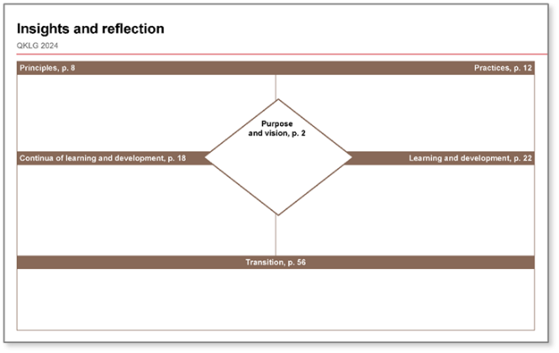

Insights and reflection sheet: The continua
Reflect
Think about the continua and how it informs your practice.
On your Insights and reflection sheet
Make notes in the ‘Continua’ section about:
key takeaways on revisions
future actions for what you will continue, start, adapt, stop.
Notes:
The continua is used for planning, teaching and learning, and reviewing evidence of learning during the teaching and learning process. Through the analysis of situation and support in the observable learning examples, a point-in-time judgment can be made about a child's learning and development, and wellbeing, against a significant learning.
Make notes about the phases of the continua and how the observable learnings and examples of these observable learnings support teachers to make consistent judgments about which phase a child’s learning is ‘more like’ in the ‘Continua’ section of your Insights and reflection sheet.

Slide 24

Module 2: Learning outline
Understanding the continua
QCAA resources to support familiarisation
Understanding learning and development areas
Supporting transitions and continuity of learning
Notes:
The continua of learning and development links to the five learning and development areas.

Slide 25
Understanding the learning and development areas
Purpose
Updated vision statement and clarified relationship to EYLF V2.0.
Principles
Refined 5.
Added 3 new.
Practices
Expanded from 3 to 7.
Refined 6.
Added 1 new.
Continua of learning and development
Added explanation of the continua phases.
Refined guidance on using the continua.
Learning and development areas
Refined structure.
Refined examples of observable learning and examples to illustrate learning across the continua.
Supporting transitions and continuity of learning
Expanded advice to include a range of transitions and refined supporting transition to school.
Notes:
Here you will have the opportunity to explore revisions to the learning and development areas.

Slide 26

Refinement to structure
Key revisions
Refined the structure of the areas to: identify critical reflection considerations for each area position key focuses to align with significant learnings merged knowledge skills and dispositions with key focuses and significant learnings refined and positioned intentional teaching strategies to follow learning.
Refined: descriptions key focuses and significant learnings observable learnings and examples.
Notes:
The learning and development areas describe the range and balance of learning that children will have the opportunity to engage in through a kindergarten program.
There have been four key revisions to the structure. Take a moment to read the slide.

Slide 27
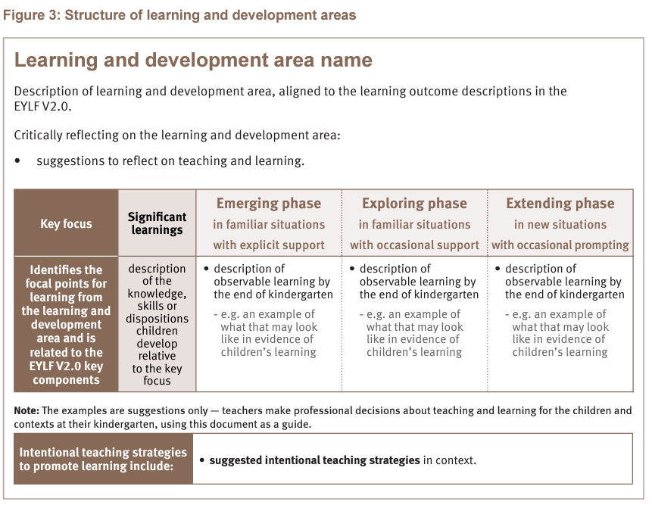
Description of learning and development
QKLG, p. 22
Notes:
Each learning and development area contains a description which is aligned to the EYLF V2.0 and describes the high-level purpose and intent of each learning area. Under this description the critical reflection section has been included and provides suggestions to reflect on teaching and learning for each learning and development area.

Slide 28
Key focus and significant learnings
QKLG, p. 22
Notes:
The QKLG has merged the knowledge, skills and dispositions with key focuses and significant learnings to reduce repetition and clarify learning. Each learning and development area has three key focuses.
A key focus identifies focal points for learning (from the description of learning and development) and has been positioned to show clearly the alignment to the significant learnings.
Significant learnings identify and describe the knowledge, skills and dispositions for learning in that key focus.

Slide 29
Supporting intentional teaching
QKLG, p. 22
Notes:
Intentional teaching strategies to promote professional decision-making for each key focus have been repositioned. This now sits under the continua table.
The intentional teaching strategies are suggestions for your consideration.

Slide 30
Refinement of learning and development areas
Key revisions
Refined structure identifies critical reflection considerations for each area positions key focuses to align with significant learnings merges knowledge, skills and dispositions with key focuses and significant learnings refines and positions intentional teaching strategies to follow learning.
Refined: descriptions key focuses and significant learnings observable learnings and examples.
Notes:
The descriptions, key focuses, significant learnings, observable learnings and examples have been refined to clarify learning.

Slide 31
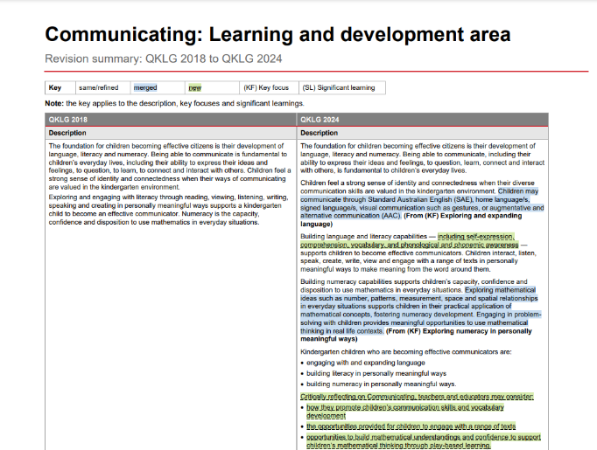

Learning and development area: Communicating
Revision summary document: Description
Merged
New
Notes:
The revision summary documents on the QCAA website outline the key changes made to the QKLG 2018. This slide shows the description revisions for Communicating.

Slide 32
Activity 5: Comparison of Communicating description
Read and reflect
Read the Comparison of the QKLG 2018 and QKLG 2024 Communicating description in your workbook (p. 6).
In your workbook — p. 6
Consider:
what has changed
questions you have
how the description informs your practice?
Notes:
Read the QKLG 2024 Communicating description in your workbook. See what has changed through the highlighting: blue indicates information merged from another section of the QKLG, and green indicates new content.
Complete Activity 5: Communication description — Module 2 workbook (p. 6).

Slide 33
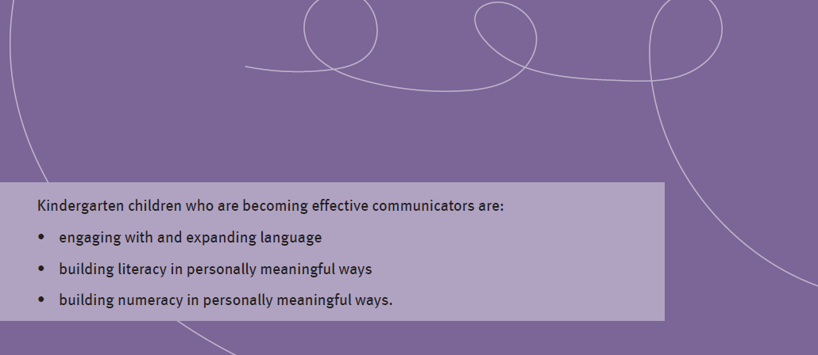
Key focuses
Notes:
In the Communicating description, three key focuses are identified. They broadly represent the intent of learning across language, literacy and numeracy.

Slide 34

Language and literacy
Engaging with and expanding language
In this key focus, children are developing their knowledge of language and how it works.
Building literacy in personally meaningful ways
In this key focus, children are applying skills and knowledge of language to engage with others around them.
Notes:
Let’s explore the following two key focuses:
engaging with and expanding language
building literacy in personally meaningful ways.

Slide 35
Activity 6: Key focuses of learning and development
In your workbook — p. 8
Connect the significant learnings that contribute to the key focus areas of ‘engaging with and expanding language’ and ‘building literacy in personally meaningful ways’.
Challenge: Attempt this activity without referring to your QKLG 2024.
Notes:
Complete Activity 6: Key focuses of learning and development — Module 2 workbook (p. 8).

Slide 36


Key focuses of learning and development
Reflect on your selections
Compare the connections you made in Activity 6 with the QKLG 2024 (pp. 49–51).
Consider:
    What was familiar?
    What surprised you?
    What would you like to know more about?
    Where can you go for more information?
Notes:
Make any notes of reflection on the Additional notes page at the end of your workbook.

Slide 37
Insights and reflection sheet: Learning and development areas
Reflect
Think about the learning and development areas and how they inform your work.
On your Insights and reflection sheet
Make notes in the ‘Learning and development areas’ section about:
key takeaways on revisions
future actions for what you will continue, start, adapt, stop.
Notes:
Reflect on:
what you have learnt about the updates to the structure and content of the learning and development areas
how these will help inform your planning
the learning and development areas with which you feel confident
which learning and development areas you would like to explore and understand further and how you will deepen your understanding of this learning and development area.
Make notes about the revisions and your future actions in the ‘Learning and development’ section of your Insights and reflection sheet.

Slide 38

Module 2: Learning outline
Understanding the continua
QCAA resources to support familiarisation
Understanding learning and development areas
Supporting transitions and continuity of learning
Notes:
Transitions occur at all different times during a child's learning and development.

Slide 39
Building understanding of supporting transitions
Purpose
Updated vision statement and clarified relationship to EYLF V2.0.
Principles
Refined 5.
Added 3 new.
Practices
Expanded from 3 to 7.
Refined 6.
Added 1 new.
Continua of learning and development
Added explanation of the continua phases.
Refined guidance on using the continua.
Learning and development areas
Refined structure.
Refined examples of observable learning and examples to illustrate learning across the continua.
Supporting transitions and continuity of learning
Expanded advice to include a range of transitions and refined supporting transition to school.
Notes:
Here you will have the opportunity to explore the final element of the QKLG, transitions.

Slide 40

Supporting transitions and continuity of learning
Key revisions
Refined to include a range of transitions children may experience
Refined language within Supporting transition to school and Transition statements
Notes:
Supporting transitions and continuity of learning is the final section of the QKLG. The two revisions reflect the range of transitions which may occur across kindergarten, including transitions to school.

Slide 41
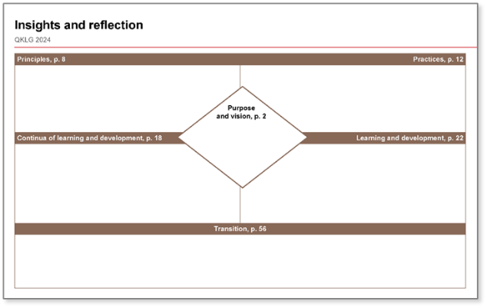
Insights and reflection sheet: Transitions
Reflect
Think about how and when transitions occur throughout the kindergarten year.
On your Insights and reflection sheet
Make notes in the ‘Transitions’ section about:
key takeaways on revisions
future actions for how you will support children across a range of transitions.
Notes:
Transitions are times of opportunity and challenge as children navigate change.
Make notes about how and when transitions occur throughout the kindergarten year in the ‘Transitions’ section of your Insights and reflection sheet.

Slide 42
Module 2: Learning outline
Understanding the continua
QCAA resources to support familiarisation
Understanding learning and development areas
Supporting transitions and continuity of learning
Notes:
You have been identifying next steps through your reflections throughout this module.
Some next steps may also include accessing resources on the QCAA the website.

Slide 43
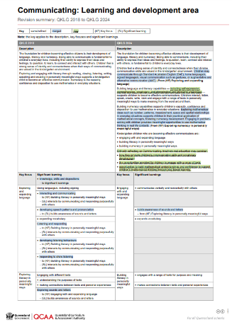

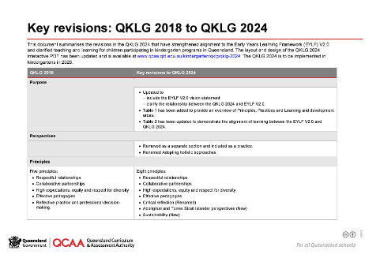
Familiarisation resources
Revision summaries include:
  QKLG 2018 to QKLG 2024
  Learning and development areas.
https://www.qcaa.qld.edu.au/kindergarten/qklg/qklg-2024/familiarisation-planning-resources
Notes:
In this module, you read through the Communicating summary document. For more information on key revisions and each of the learning and development areas, access the familiarisation resources listed on the slide using the QR code and the QCAA website.

Slide 44
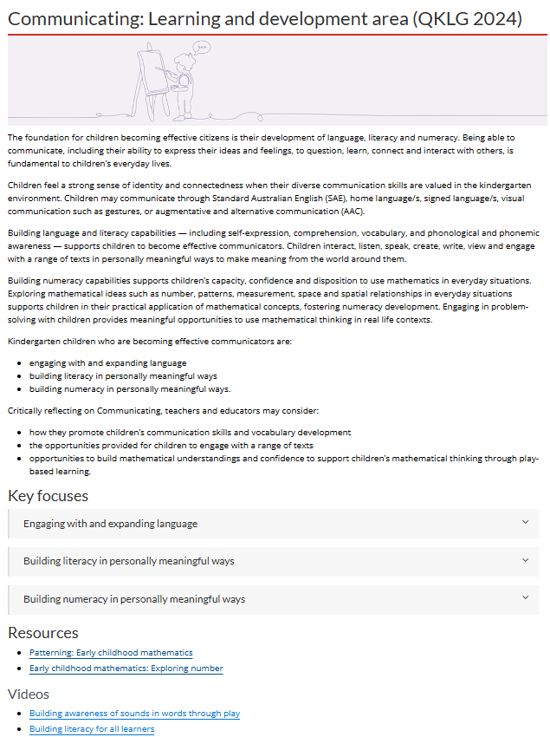
Learning and development resources
Supporting resources and videos.
Notes:
Access supporting resources and videos about the learning and development areas on the QCAA website.

Slide 45
QKLG 2024: Familiarisation and planning
Module 1 Exploring revisions to purpose, principles and practices
QKLG 2024 and
EYLF V2.0 alignment
Purpose, principles and practices
Module 2
Exploring continua and reviewing transitions
Continua of learning and development
Learning and development areas
Module 3
Examining considerations for planning
Considerations for planning with the QKLG 2024
Supporting transitions and continuity of learning
Notes:
Congratulations on completing Module 2. You can continue your learning journey with Module 3. This module will further enhance your understanding of the QKLG 2024.

Slide 46
Contact us
K–10 Curriculum and Assessment Branch
E qklg@qcaa.qld.edu.au
Notes:
Contact us: qklg@qcaa.qld.edu.au

Slide 47
References
Australian Government Department of Education 2022, ‘Belonging, Being and Becoming: The Early Years Learning Framework for Australia V2.0’, ACECQA: Approved learning Frameworks Version 2.0 – Communications toolkit, www.acecqa.gov.au/acecqa-approved-learning-frameworks-version-2.0-communications-toolkit.

Slide 48
Acknowledgments
Third-party copyright material, and QCAA material not covered by the CC BY licence is listed below:
Queensland Government coat of arms, and the QCAA and QSA trademarks may not be reproduced without permission.
Acknowledgment of Country artwork (2023) ‘Growth through Learning’ by Chern’ee, Brooke and Jesse Sutton, Kalkadoon. www.cherneesutton.com.au
Student and staff images have been used with permission.

Slide 49
Copyright notice
© State of Queensland (QCAA) 2024
Licence: https://creativecommons.org/licenses/by/4.0 | Copyright notice: www.qcaa.qld.edu.au/copyright — lists the full terms and conditions, which specify certain exceptions to the licence.
Attribution (include the link): © State of Queensland (QCAA) 2024 www.qcaa.qld.edu.au/copyright.
Other copyright material in this presentation is listed on the previous slide/s.

Slide 50
QCAA social media

