Slide 1
This presentation is part of a self-paced learning package for kindergarten services. The package contains guidance and additional resources.
Read — Self-paced learning package: Guidance. This will provide the context and purpose of the module.
Prepare your materials. Ensure you have a copy (printed or digital) of the:
QKLG 2024
Module 1: Workbook
Module 1: Insights and reflection sheet.
Check the notes section. Each slide may include additional information in the notes section (use Normal view).
Before you start

Slide 2
Look for activity icons.
Throughout this presentation, icons are used indicate different activities.
Before you start
Refer to your workbook
Pause and reflect
Refer to the QKLG 2024

Slide 3
Familiarisation and planning self-paced learning
241168
Module 1: Exploring revisions to the QKLG 2024 purpose, principles and practices
Notes:
Welcome to familiarisation and planning with the Queensland kindergarten learning guideline (QKLG) 2024.

Slide 4
Acknowledgment of Country
Notes:
Acknowledgment of Country
Please read.

Slide 5
QKLG: Familiarisation and planning
Module 1 Exploring revisions to purpose, principles and practices
QKLG 2024 and EYLF V2.0 alignment
Purpose, principles and practices
Module 2
Exploring continua and reviewing transitions
Continua of learning and development
Learning and development areas
Module 3
Examining considerations for planning
Considerations for planning with the QKLG 2024
Supporting transitions and continuity of learning
Notes:
This is Module 1 of the QKLG 2024 self-paced learning package.
This module explores the purpose, principles and practices of the QKLG 2024. It is the self-paced version of the familiarisation and planning workshop of the same title.

Slide 6
Overview: Revised QKLG elements
Module 1
Purpose
Updated vision statement and clarified relationship to EYLF V2.0.
Principles
Refined: 5
Added: 3
Practices
Expanded: 3 to 7
Refined: 6
Added: 1
Continua of learning and development
Added: Explanation of continua phases
Refined: Guidance on using continua
Refined:
Structure
Examples of observable learning
Examples to illustrate learning across continua
Module 2
Learning and development areas
Supporting transitions and continuity of learning
Expanded: The range of transitions in the advice. Refined: Supporting transition to school.
Notes:
The QKLG contains six interconnected elements, all of which have been revised.
This diagram shows how each of the elements has been revised — either refined, expanded, or added to.
The diagram will also guide you through the familiarisation package and show the progression toward Module 3: Identifying considerations for planning with the QKLG 2024.
In Module 1, we focus on the revisions to the purpose, principles and practices. You will have the opportunity to reflect on any actions that you may take.

Slide 7
Learning goal
Success criteria
To understand the updates and revisions in the QKLG 2024 for implementation.
You will know you are successful if you can:
strengthen your knowledge of the QKLG 2024 purpose, principles and practices
identify QCAA resources to support familiarisation
identify actions to support implementation.
Notes:
At the end of this module, you should understand the updates and revisions in the QKLG 2024. You will have:
strengthened your knowledge of the QKLG 2024 purpose, principles and practices
identified QCAA resources to support familiarisation
identified actions to support implementation.

Slide 8
Module 1: Learning outline
Purpose
QCAA resources to support familiarisation
Principles
Practices
Notes:
The topics covered in this module are QKLG 2024:
Purpose
Principles
Practices
QCAA resources to support familiarisation.
You will see this diagram at the start of each new topic in the module.
Let’s begin by exploring the purpose of the QKLG.

Slide 9
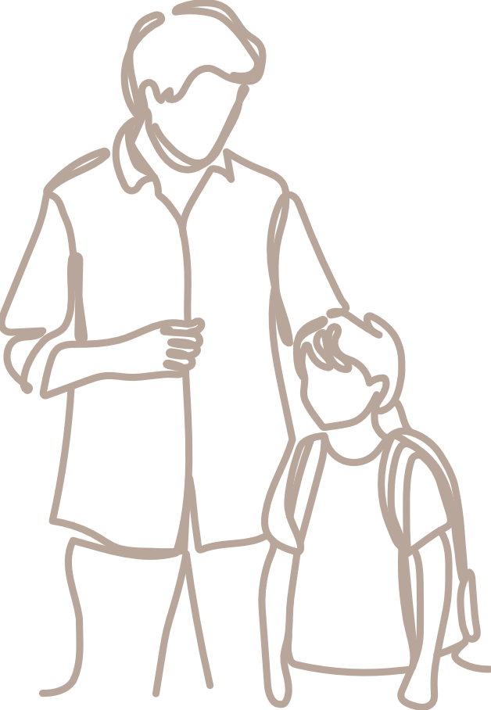
Purpose — supporting continuity and transitions in early learning
Early Years Learning Framework V2.0
P–10 Australian Curriculum
5 years
Birth
QKLG
Transition statement
Notes:
When considering the purpose of the QKLG, we must first understand that the QKLG 2024 aligns with and draws on the Early Years Learning Framework (EYLF) V2.0 for continuity of learning prior to kindergarten and looks forward and recognises the learning children will engage in beyond kindergarten.
A key purpose of the QKLG is to support the transitions and continuity of learning for children. Transition statements are a part of that process.

Slide 10
Purpose — adopting the EYLF V2.0 vision
Key revisions
Updated to include the EYLF V2.0 vision statement
Clarified the relationship between the QKLG 2024 and EYLF V2.0 Included a new table — Table 1 Updated learning alignment in Table 2
Notes:
The QKLG adopts the vision of the EYLF in its purpose and the QKLG 2024 has been updated to align with the EYLF V2.0 vision.

Slide 11
Activity 1: Purpose — adopting EYLF vision
Read and reflect
Read the purpose statement of the QKLG (p. 2), which includes the vision adopted from the EYLF V2.0.
Identify the key ideas.
In your workbook — p. 2
Reflect on how the purpose statement and vision can support your planning.
Notes:
To understand the purpose of the QKLG:
read Purpose — QKLG (p. 2) then identify how it includes the EYLF vision and its key ideas
complete Activity 1: Reflect on the purpose — Module 1 workbook (p. 3).

Slide 12
Purpose — clarified alignment with EYLF V2.0
Key revisions
Updated to include the EYLF V2.0 vision statement
Clarified the relationship between the QKLG 2024 and EYLF V2.0 included a new table — Table 1 updated learning alignment in Table 2
Notes:
Note that the purpose of the QKLG now clarifies the relationship between the EYLF V2.0 and the QKLG 2024 with:
the addition of Table 1: QKLG principles, practices and learning and development areas
updated learning alignment in Table 2: Alignment of learning between EYLF V2.0 and QKLG.

Slide 13
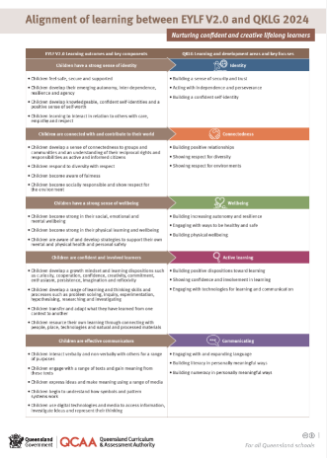
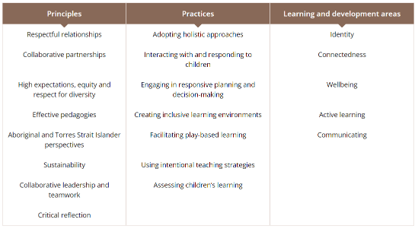
Purpose — clarified alignment with EYLF V2.0
New
Table 1: QKLG principles, practices and learning development areas
Revised
Table 2: Alignment of learning between EYLF V2.0 and QKLG
See QKLG 2024 (pp. 3, 4 and 5)
Notes:
To support the clarified alignment between the EYLF V2.0 and the QKLG 2024, you will find that:
Table 1 — provides an overview of the QKLG principles, practices and learning and development areas that are aligned to the EYLF V2.0
Table 2 — provides an overview of the learning alignment between EYLF learning outcomes and key components, and the QKLG learning and development areas and key focuses.

Slide 14
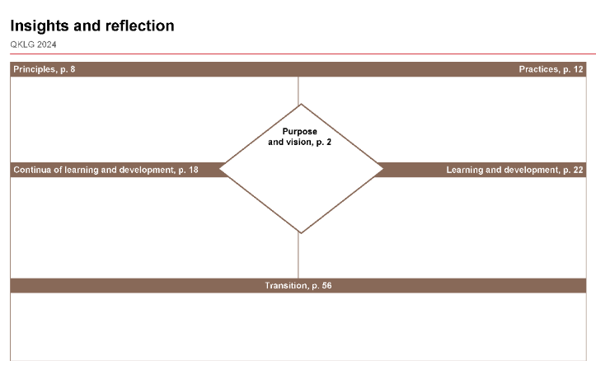
Reflect on revisions to the purpose
Reflect
Think about changes to the purpose and how they inform your planning and practice.
Use the insights and reflection sheet
1. Make notes in the ‘Purpose and vision’ section about:
key takeaways on revisions
future actions for what you will continue, start, adapt, stop.
Notes:
Think about what has changed in the purpose and how this will inform your planning and practice. How could you explain the relationship between the EYLF V2.0 and QKLG 2024. Why might this be important in your work?

Slide 15
Module 1: Learning outline
Purpose
QCAA resources to support familiarisation
Principles
Practices
Notes:
The next part of this module looks at strengthening knowledge of the principles.

Slide 16
Understanding the updated principles
Key revisions
Refined: 5 principles
Renamed: 1 principle (Reflective practice and professional decision-making > Critical reflection)
New — 3 principles: Aboriginal and Torres Strait Islander perspectives Sustainability Collaborative leadership and teamwork
Notes:
The language of five principles has been refined. One principle has been renamed and the three new principles of Aboriginal and Torres Strait Islander perspectives, sustainability, and collaborative leadership and teamwork have been added.

Slide 17
Activity 2a: Reviewing refined principles
Read, investigate and reflect
Read the five principles with language refinements (QKLG, pp. 8–10):
Respectful relationships
High expectations, equity and respect for diversity
Collaborative partnerships
Effective pedagogies
Critical reflection.
In your workbook — p. 3
Reflect on these principles and identify how they inform your professional practice.
Notes:
To review the refined principles:
read Principles — QKLG (pp. 8–10)
complete Activity 2a: Reflect on the refined principles — Module 1 workbook (p. 3).

Slide 18
Activity 2b: Exploring the new principles
Read and investigate
Read the three new principles (QKLG pp. 9–10)
Aboriginal and Torres Strait Islander perspectives
Sustainability
Collaborative leadership and teamwork.
In your workbook — pp. 3–6
Use the graphic organisers to:
identify familiar information
note interesting information
reflect on how this shapes your understanding
consider how to share this with colleagues.
Notes:
Complete Activity 2b in your workbook for each of the three new principles — Module 1 workbook (p. 3).

Slide 19
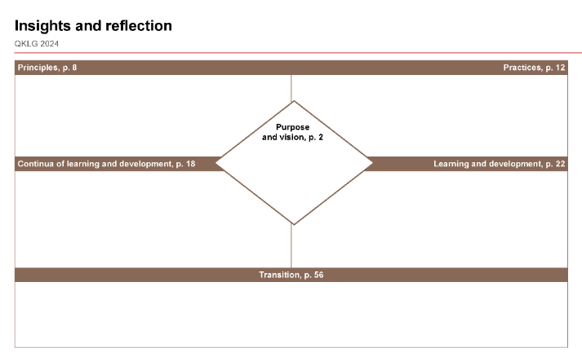
Insights and reflection sheet: Principles
Reflect
The principles promote our way of working with children. Reflect on the revisions to the principles.
On your Insights and reflection sheet
Make notes in the ‘Principles’ section about:
key takeaways on revisions
future actions for what you will continue, start, adapt, stop.
Notes:
The principles are the shared values of early childhood that infuse the practices and the learning and development areas.
Make notes about the revisions and your future actions in the ‘Principles’ section of your Insights and reflection sheet.

Slide 20
Module 1: Learning outline
Purpose
QCAA resources to support familiarisation
Principles
Practices
Notes:
The practices bring the principles of the QKLG 2024 to life through the facilitation of the teaching and learning program.

Slide 21
Understanding expanded practices
Key revisions
Expanded: 3 to 7 repositioned 3 renamed 5
New: 1
Notes:
The practices have expanded from 3 to 7. The following slides explain this expansion.

Slide 22
Understanding the expanded practices
Decision-making sub-elements:
Previously two sub-elements of advice.
Now individual practices.
Renaming of practices:
Highlights active, intentional teaching.
Consistent across all practices.
QKLG 2018 | QKLG 2024
Decision-making developing learning contexts interacting with and responding to children | Decision-making Engaging in responsive planning and decision-making
 | Developing learning contexts Facilitating play-based learning
 | Interacting with and responding to children
Intentional teaching practices | Using intentional teaching strategies
Assessment | Assessing children’s learning
Notes:
In the QKLG 2018, decision-making had two sub-elements of advice. These sub-elements have been repositioned as individual practices.

Slide 23
Understanding expanded practices
QKLG 2018 | QKLG 2024
Decision-making developing learning contexts interacting with and responding to children | Decision-making Engaging in responsive planning and decision-making
 | Developing learning contexts Facilitating play-based learning
 | Interacting with and responding to children
Intentional teaching practices | Using intentional teaching strategies
Assessment | Assessing children’s learning
Notes:
The renaming of the practices highlights the active and intentional practice of teachers to inform approaches to, and planning for, children’s learning development and wellbeing.

Slide 24
Understanding expanded practices
QKLG 2018 | QKLG 2024
Decision-making developing learning contexts interacting with and responding to children | Decision-making Engaging in responsive planning and decision-making
 | Developing learning contexts Facilitating play-based learning
 | Interacting with and responding to children
Intentional teaching practices | Using intentional teaching strategies
Assessment | Assessing children’s learning
Perspectives (repositioned) | Adopting holistic approaches
Notes:
Adopting holistic approaches appears to be a new practice but it is the perspectives information (from the QKLG 2018) repositioned and renamed.
In each practice, there have also been revisions in the content. For example, you will see two new intentional teaching strategies; a strengthened focus on play (as both a context and process for learning) and assessing now includes assessment, for, of and as learning.

Slide 25
Understanding the new practice
Revisions
Expanded: 3 to 7 repositioned 3 renamed 5
New: Creating inclusive learning environments
Notes:
The new practice is Creating inclusive learning environments. It has been included to show alignment with the strengthened focus on environments in the EYLF V2.0.

Slide 26
Understanding intentional practices
The QKLG practices inform the intentional approaches and practices of teachers and educators.
In the next few slides, you will:
explore the new practice through the lens of intentionality
unpack the big ideas that inform intentionality when planning inclusive learning environments, using feedback from workshops and your own reflections.
Notes:
The QKLG practices inform the intentional approaches and practices of teachers and educators.

Slide 27
Exploring intentionality in the practices
Read and investigate
Read the Creating inclusive learning environments practice (QKLG, p. 13).
Highlight key language that reflects intentional practices.
Notes:
This reflection will explore practices through the lens of intentionality.
Read the Creating inclusive learning environments practice in the QKLG 2024.
Highlight key language that reflects intentional practices.
Reflect on how you enact this practice in your context.
This can activity could be repeated with any practice.

Slide 28
Assessing children’s learning in the QKLG 2024
Assessment can be …
Formative
as learning
Summative
of learning
for learning
Notes:
Assessing children’s learning is an area which had undergone significant revision with a change in language to include assessment, for, as and of learning.

Slide 29
Assessing children’s learning — Assessment for learning
Read and investigate
Read the Assessing children's learning practice QKLG (p. 16).
Highlight or note key words and ideas in the Assessment for learning section QKLG (p. 16).
Notes:
This reading will explore the practice of Assessment for learning.
Read the Assessing children's learning practice in the QKLG 2024.
Highlight or note key words or ideas in the Assessment for learning section QKLG.

Slide 30
Assessing children’s learning — Assessment for learning
You may have highlighted that assessment for learning is:
ongoing
informs planning
builds understanding of children’s learning.
Note:
The term for in assessment refers to formative assessment, which is used to gather information that informs planning and ongoing learning.

Slide 31
Assessing children’s learning — Assessment as learning
Read and investigate
Read the Assessing children's learning practice QKLG (p. 16).
Highlight or note key words and ideas in the Assessment as learning section QKLG (p. 16).
Notes:
Next, we look at the practice of Assessment as learning.
Read the Assessing children's learning practice in the QKLG 2024.
Highlight or note key words or ideas in the Assessment as learning section QKLG.

Slide 32
Assessing children’s learning — Assessment as learning
You may have highlighted the following terms to represent important points:
children
reflection
as learning.
Note:
The term as refers to assessment happening as children work with others to reflect on and understand their own learning.
Notes:
These terms represent important points in Assessment as learning:
children
reflection
as learning.

Slide 33
Assessing children’s learning — Assessment of learning
Read and investigate
Read the Assessing children's learning practice QKLG (p.16).
Highlight or note key words and ideas in the Assessment of learning section QKLG (p.16).
Notes:
Finally, we explore the practice of Assessment of learning.
Read the Assessing children's learning practice in the QKLG 2024.
Highlight or note key words or ideas in the Assessment of learning section QKLG.

Slide 34
Assessing children’s learning — Assessment of learning
You may have highlighted following important points:
point in time
review of learning
snapshot
summary
progress
sharing of information.
Remember:
The term ‘assessment of ’ indicates learning that has occurred and is collected at a point in time, as a snapshot or summary of the learning.

Slide 35
Activity 3 — Assessing children’s learning
In your workbook — p. 7
Complete Activity 3:
Reflect on how you enact this practice in your own context.
Consider the methods you use to collect evidence.
Document the ways you gather and record this evidence.
Notes:
Complete Activity 3 in your workbook — Module 1 workbook (p. 7).

Slide 36
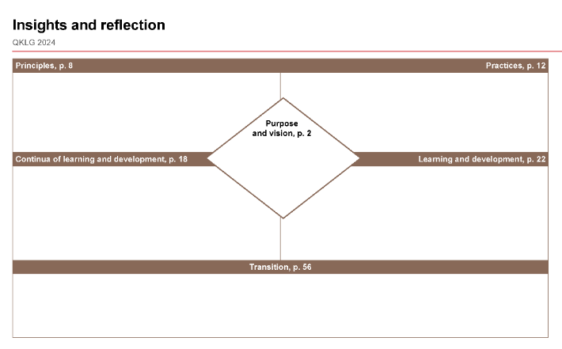
Insights and reflection sheet: Practices
Reflect
The practices support quality teaching, learning and assessment in Queensland kindergartens. Reflect on the revisions to the principles.
On your Insights and reflection sheet
Make notes in the ‘Practices’ section about:
key takeaways on revisions
future actions for what you will continue, start, adapt, stop.
Notes:
Reflect on the revisions within the practices and the expansion of 3 to 7.
What does this mean for you? What did the activities highlight for you about your understanding and use of practices in your approaches and planning for, children’s learning, development and wellbeing?
Make notes about the revisions and your future actions in the ‘Practices’ section of your Insights and reflection sheet.

Slide 37
Module 1: Learning outline
Purpose
QCAA resources to support familiarisation
Principles
Practices
Notes:
You have been identifying next steps through your reflections in this module.
Some next steps may also include accessing resources on the QCAA the website.

Slide 38
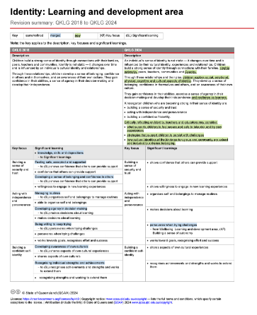
Familiarisation resources
Revision summaries include:
Key revisions QKLG 2018 to QKLG 2024
Learning and development areas.
https://www.qcaa.qld.edu.au/kindergarten/qklg/qklg-2024/familiarisation-planning-resources
Notes:
Familiarisation resources are available on the QCAA website in the QKLG 2024: Familiarisation and planning resources section. Use the QR code to take you to the website.

Slide 39
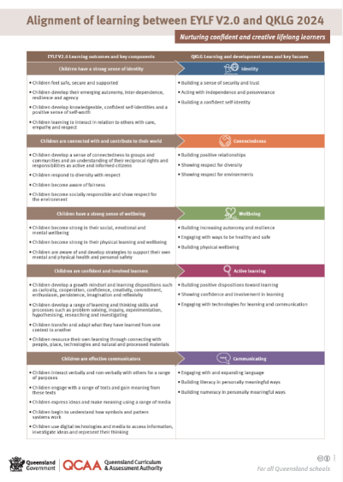
Learning alignment poster
Notes:
The updated learning alignment poster is available from the Purpose > Resources section.

Slide 40
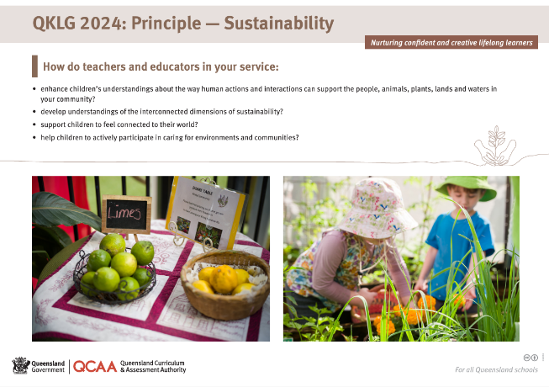
Poster resources for each principle
Notes:
New poster resources are available for each principle to support professional discussions and the sharing of ideas.

Slide 41
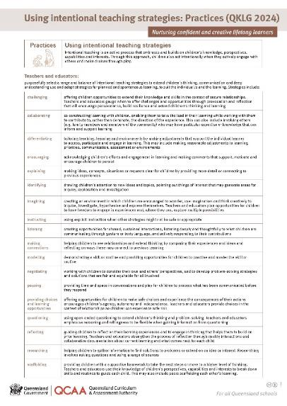
Intentional teaching strategies poster
Notes:
A new poster outlining the intentional teaching strategies is also available.
An activity to further reflect on this practice is to highlight the strategies you use most often. Identify those you use less often and consider how these can be woven into your current practice.

Slide 42
QKLG: Familiarisation and planning
Module 1 Exploring revisions to purpose, principles and practices
QKLG 2024 and EYLF V2.0 alignment
Purpose, principles and practices
Module 2
Exploring continua and reviewing transitions
Continua of learning and development
Learning and development areas
Module 3
Examining considerations for planning
Considerations for planning with the QKLG 2024
Supporting transitions and continuity of learning
Notes:
Congratulations on completing Module 1. You can continue your learning journey with Modules 2 and 3. These modules will further enhance your understanding of the QKLG 2024.

Slide 43
Contact us
K–10 Curriculum and Assessment Branch
E qklg@qcaa.qld.edu.au
Notes:
Contact us: qklg@qcaa.qld.edu.au

Slide 44
References
Australian Government Department of Education 2022, ‘Belonging, Being and Becoming: The Early Years Learning Framework for Australia V2.0’, ACECQA: Approved learning Frameworks Version 2.0 – Communications toolkit, www.acecqa.gov.au/acecqa-approved-learning-frameworks-version-2.0-communications-toolkit.
Harvard Graduate School of Education 2020, ‘The See Think Me We: Thinking routine’, Project zero resources, https://pz.harvard.edu/resources/see-think-me-we.
Australian Children’s Education and Care Quality Authority 2024, ‘Guide to the National Quality Framework: Interactive PDF’, Guide to the NQF, www.acecqa.gov.au/nqf/about/guide.

Slide 45
Acknowledgments
Third-party copyright material, and QCAA material not covered by the CC BY licence is listed below:
Queensland Government coat of arms, and the QCAA and QSA trademarks may not be reproduced without permission.
Acknowledgment of Country artwork (2023) ‘Growth through Learning’ by Chern’ee, Brooke and Jesse Sutton, Kalkadoon. www.cherneesutton.com.au
Student and staff images have been used with permission.

Slide 46
Copyright notice
© State of Queensland (QCAA) 2024
Licence: https://creativecommons.org/licenses/by/4.0 | Copyright notice: www.qcaa.qld.edu.au/copyright — lists the full terms and conditions, which specify certain exceptions to the licence. | Attribution (include the link): © State of Queensland (QCAA) 2024 www.qcaa.qld.edu.au/copyright.
Other copyright material in this presentation is listed on the previous slide/s.

Slide 47
QCAA social media
Notes:
To keep up to date with the release of resources and provision of professional learning, follow the QCAA on one or more social media platforms.

